Slide 1
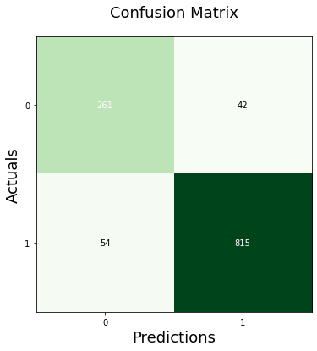
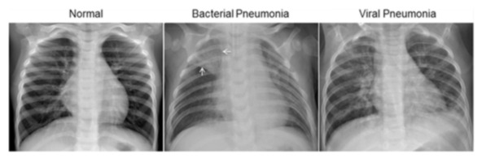
Identifying Diseases in Chest X-ray
Computer Vision Track
Team Members Names – Supervised by: Dr. Ahmed Afifi
Pneumonia is a respiratory infection caused by bacteria or viruses; it affects many individuals, especially in developing and underdeveloped nations. This project focuses on detecting pneumonia in x-rays for kids. We employed deep learning to handle the available data with the CNN algorithm to classify it into pneumonia or normal The proposed method achieved an accuracy rate of 92%.
keyword: X-ray,Pneumonia,Computer Tomogrophy, CNN algorithem
الالتهاب الرئوي هو عدوى الجهاز التنفسي التي تسببها البكتيريا أو الفيروسات. إنه يؤثر على العديد من الأفراد ، خاصة في الدول النامية والمتخلفة. يركز هذا المشروع على الكشف عن الالتهاب الرئوي في الأشعة السينية للأطفال. استخدمنا التعلم العميق للتعامل مع البيانات المتاحة باستخدام خوارزمية CNN لتصنيفها إلى التهاب رئوي أو عادي. حققت الطريقة المقترحة معدل دقة بنسبة 92٪.
Pneumonia and malaria are perhaps the two biggest contributors to juvenile mortality across the world.
Measuring pneumonia burden is difficult since there is wide variation in its presentation particularly in children and the multiple etiological agents associated with the disease. It is also well known that clinical signs of malaria and measles overlap with those of pneumonia and there is lack of clinical signs in malnourished children leading to misclassification error. As per Lancet report, in 2015, India, Nigeria, Indonesia, Pakistan, and China contributed to more than 54% of all global pneumonia cases, with 32% of the global burden from India alone. This makes India sharing the highest burden of pneumonia in the world.
For the analysis of chest x-ray images, all chest radiographs were initially screened for quality control by removing all low-quality or unreadable scans. The diagnoses for the images were then graded by two expert physicians before being cleared for training the AI system.
We used CNN to train on a number of chest X-rays and predict whether pneumonia is present or not. We dealt with gray-scale chest X-ray images. We tried models and we found ResNet50 to be the best one, with the highest accuracy.
Chest X-ray images (anterior-posterior) were selected from retrospective cohorts of pediatric patients aged one to five years old at the Guangzhou Women's and Children’s Medical Center, Guangzhou. All chest X-ray imaging was performed as part of patients’ routine clinical care. The dataset has two categories (Pneumonia/Normal).
The proposed method achieved an accuracy rate of 92% on the x-ray datasets as shown below evaluation metrics for the Confusion Matrix.

